Slide 1



Introduction to Circuit Switching and Network Security
Explore the fundamentals of circuit switching technology and the critical aspects of securing these networks against threats and vulnerabilities.
by AYANABHA CHATTERJEE
BWU/BCA/22/411

Slide 2
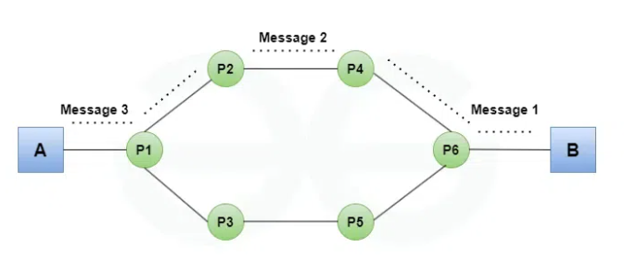

Slide 3
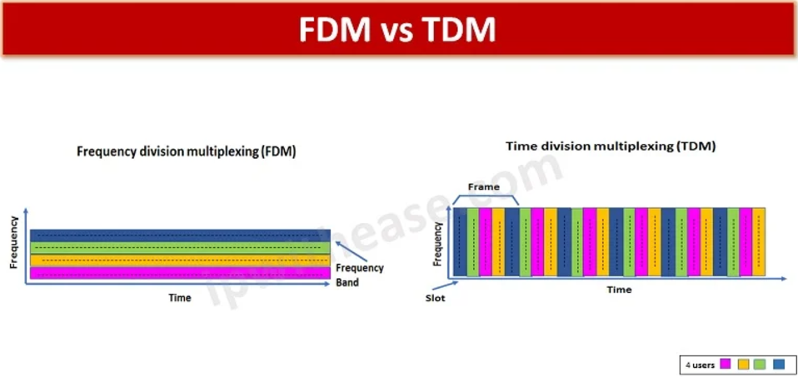

Slide 4


Overview of Circuit Switching Technology
1
Call Establishment
Dedicated communication path created between two endpoints.
2
Reliable Transmission
Consistent bandwidth and low latency for the duration of the call.
3
Connection Termination
Path released when the call ends, freeing up resources.

Slide 5

Principles of Circuit-Switched Networks
Dedicated Channels
Centralized Control
Predictable Performance
Exclusive use of communication path for the duration of the call.
Network switches manage call routing and resource allocation.
Guaranteed bandwidth and low latency for real-time applications.

Slide 6


Advantages and Disadvantages of Circuit Switching
1
Advantages
2
Disadvantages
Reliable, low latency, and secure communication.
Limited flexibility, inefficient for bursty data, and high setup costs.

Slide 7

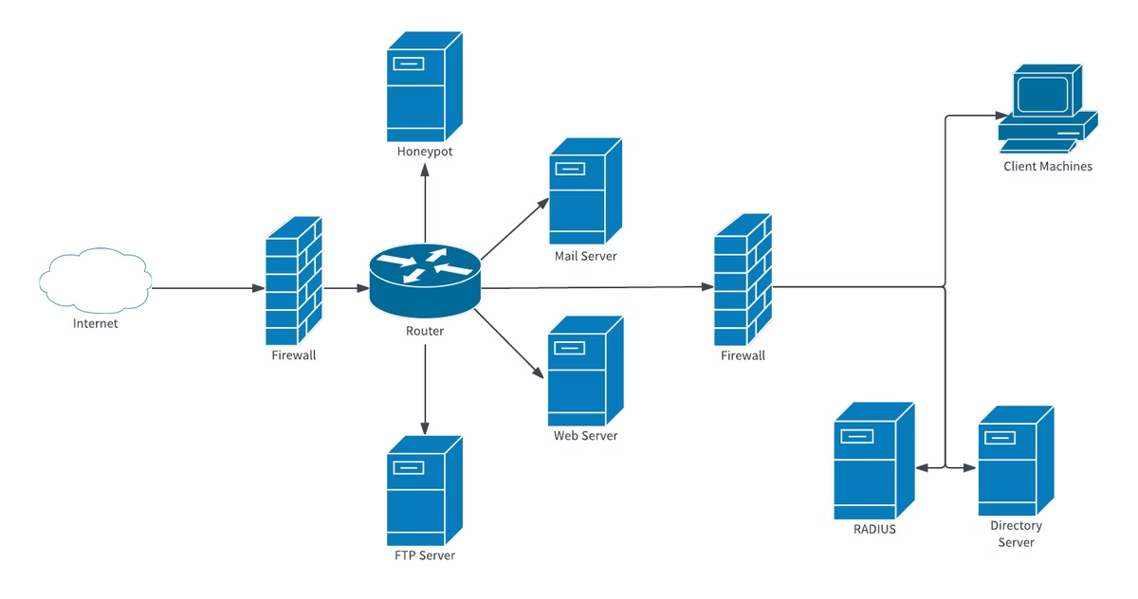
Fundamentals of Network Security
Confidentiality
Integrity
Protecting sensitive information from unauthorized access.
Ensuring data is not tampered with or modified.
Availability
Guaranteeing reliable and uninterrupted access to network resources.

Slide 8

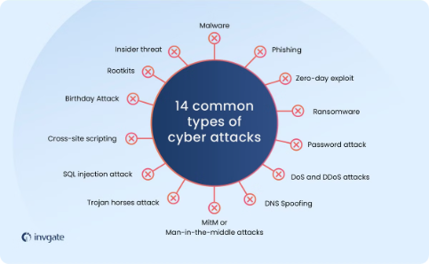



Threats and Vulnerabilities in Circuit-Switched Networks
Eavesdropping
DoS Attacks
Man-in-the-Middle
Unauthorized access to call content and metadata.
Disrupting network services and call connectivity.
Intercepting and modifying communication between parties.

Slide 9





Security Measures for Circuit-Switched Networks
Encryption
Protect call content and signaling data.
Access Control
Restrict unauthorized access to network resources.
Monitoring and Logging
Detect and respond to security incidents

Slide 10


